Slide 1
RATING PREDICTION PROJECT
By Femina Aneesh

Slide 2
Problem statement
We have a client who has a website where people write different reviews for technical products. Now they are adding a new feature to their website i.e. The reviewer will have to add stars(rating) as well with the review. The rating is out 5 stars and it only has 5 options available 1 star, 2 stars, 3 stars, 4 stars, 5 stars. Now they want to predict ratings for the reviews which were written in the past and they don’t have a rating. So, we have to build an application which can predict the rating by seeing the review .

Slide 3
Conceptual Background of the Domain Problem
The rise in E — commerce, has brought a significant rise in the importance of customer reviews. There are hundreds of review sites online and massive amounts of reviews for every product. Customers have changed their way of shopping and according to a recent survey, 70 percent of customers say that they use rating filters to filter out low rated items in their searches.
The ability to successfully decide whether a review will be helpful to other customers and thus give the product more exposure is vital to companies that support these reviews, companies like Google, Amazon and Yelp!.
In recent years, recommendation systems (RecSys) have been extensively used in variousdomains to recommend items of interest to users based on their proﬁles. RecSys are an integral part of manyonline stores such as Alibaba.com, Amazon.com, etc. One of the most famous examples of a recommenda-tion system is Amazon [4].

Slide 4
This system contains movie ratings for over 100,000 movies.A user’s proﬁle is a reﬂection of the user’s previous selections and preferences that can be capturedas rating scores or textual review given to different items in the system. Using preference data, differentsystems have been developed to produce personalized recommendations based on collaborative ﬁltering,content-based or a hybrid approach.
Recommendation systems are an important units in today's e-commerce applications, such as targeted advertising, personalized marketing and information retrieval. In recent years, the importance of contextual information has motivated generation of personalized recommendations according to the available contextual information of users. Compared to the traditional systems which mainly utilize users' rating history, review-based recommendation hopefully provide more relevant results to users. A review-based recommendation approach that obtains contextual information by mining user reviews.

Slide 5
• Review of Literature
This project is more about exploration,feature engineering and classification that can be done on this data.Since we scrape huge amount of data that includes five stars rating,we can do better data exploration and derive some interesting features using the available columns.
We can categorize the ratings as 1.0,2.0,3.0 and 5.0 stars
The goal of the project is to build an application which can predict the rating by seeing the review.In the long term,this would allow people to better explain and reviewing their purchase with each other in this increasingly digital world.

Slide 6
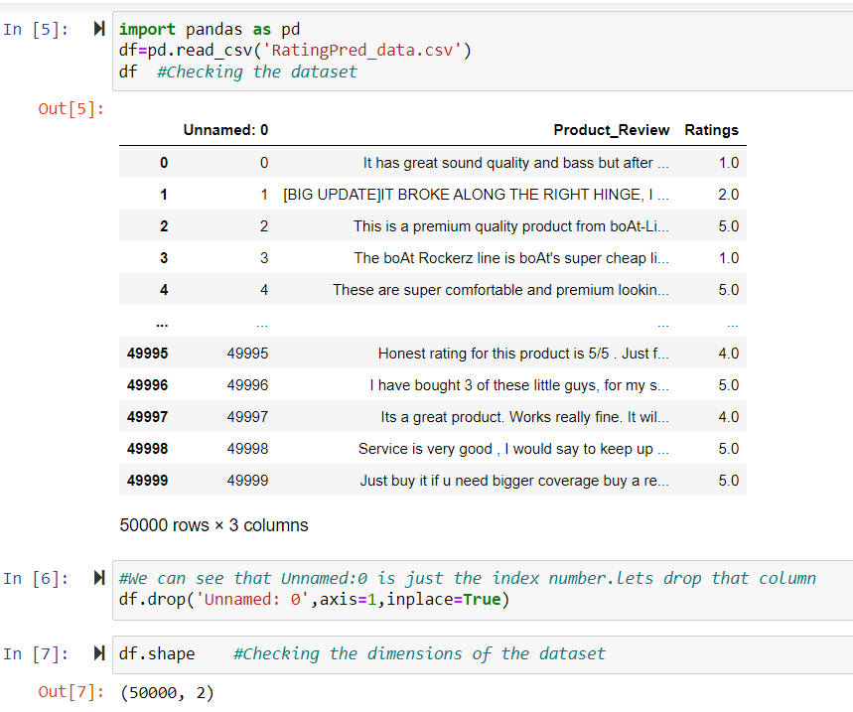
• Data Sources and their formats
We collected the data from different e-commerce websites like Amazone and Flipkart.The data is scrapped using web scraping technique and the framework used is Selenium.We scrapped nearly 50000 of the reviews data and saved each data in a separate data frame.In the end ,we combined all the data frames into a single data frame and it looks like as follows:

Slide 7
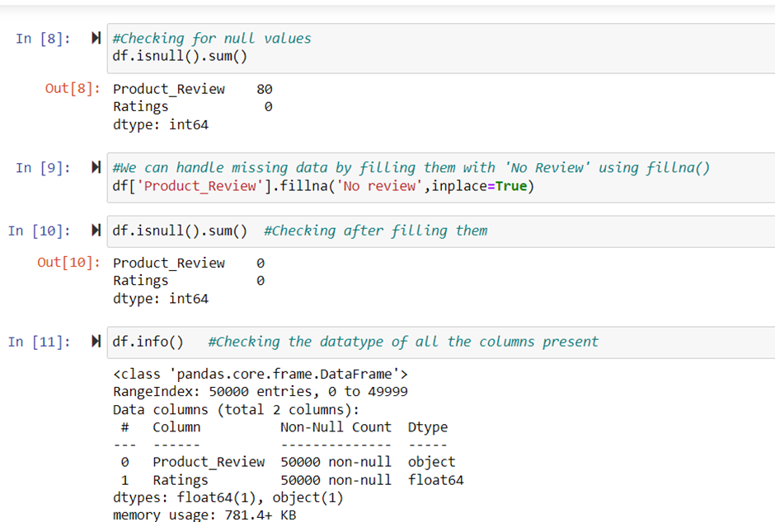
• Data Preprocessing Done
Handling missing data using fillna and checking the datatypes.

Slide 8
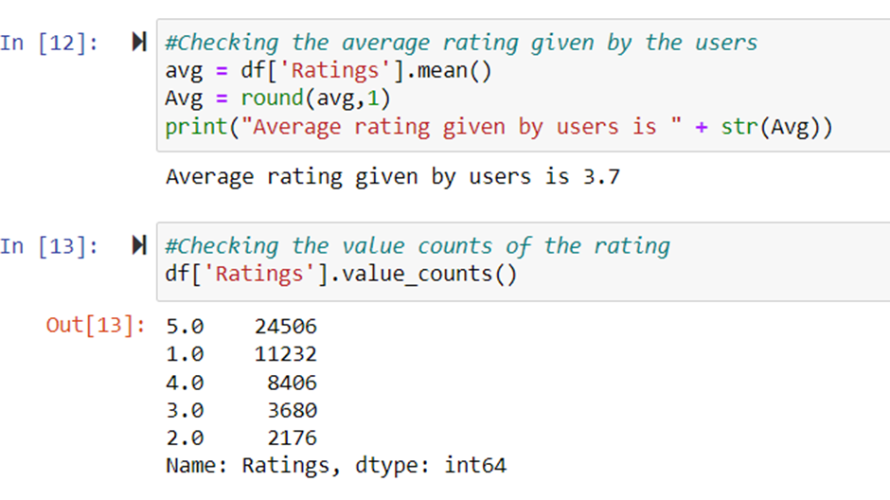
Checking average rating and value counts of each rating present

Slide 9
Pre-Processing using Natural Language Processing (NLP)
We cleaned the data using regex, matching patterns in the comments and replacing them with more organized counterparts. cleaner data leads to a more efficient model and higher accuracy. Following steps are involved.
1.Removing Punctuations and other special characters.
2.Splitting the comments into individual words.
3.Removing Stop Words.
There is a corpus of stop-words that, are high-frequency words such as “the”, “to” and “also”, and that we sometimes want to litter out of a document before further processing. Stop-words usually have little lexical content, don’t alter the general meaning of a sentence and their presence in a text fails to distinguish it from other texts.We used the one from Natural Language Toolkit a leading platform for building Python programs to work with human language.
The code is attcached below.

Slide 10
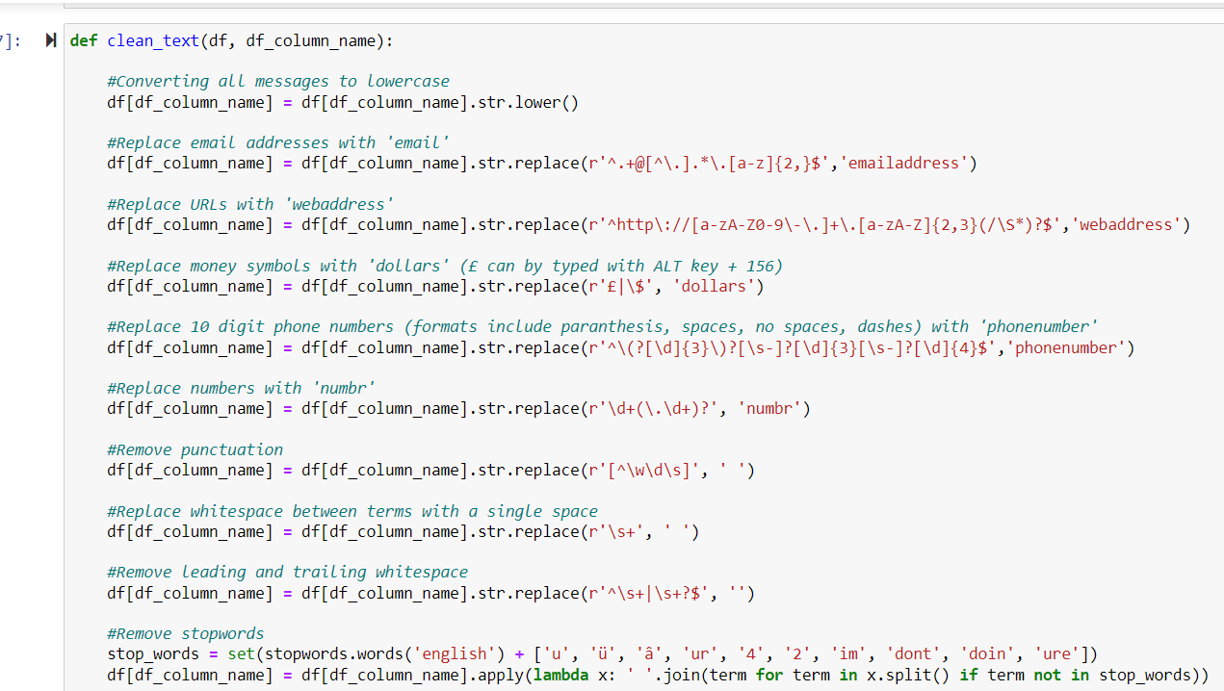

Slide 11
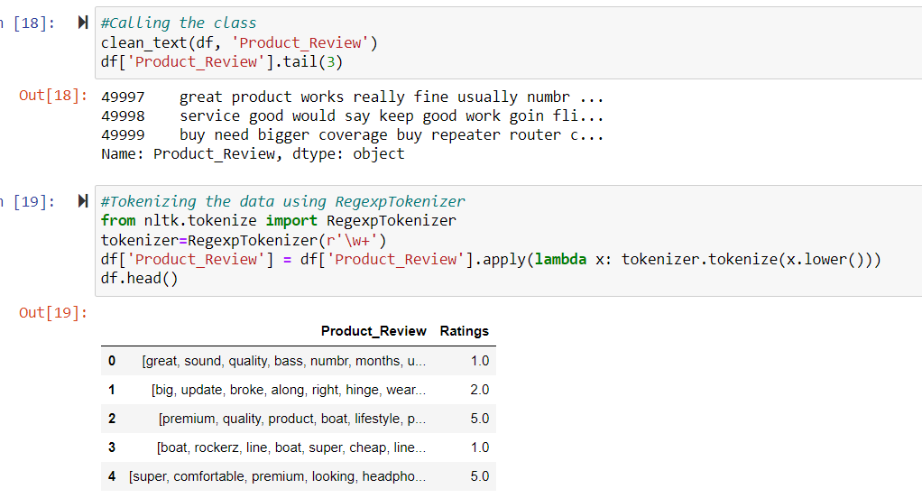
Tokenizing the data using RegexpTokenizer

Slide 12
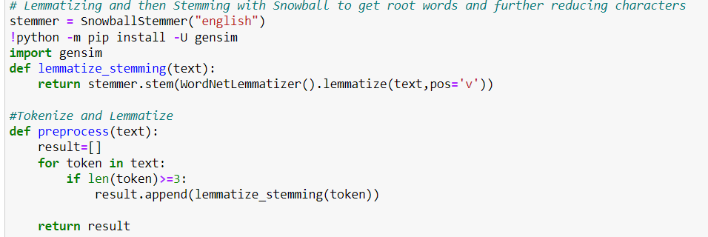
Stemming and Lemmatizing

Slide 13
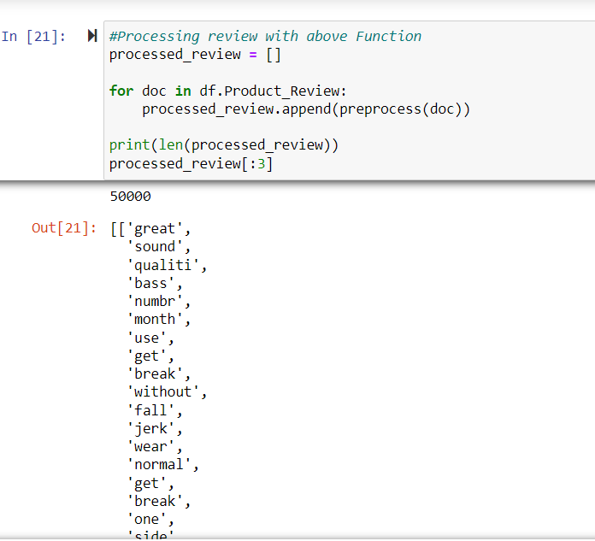
Processing the review and assigning the updated review in the data frame

Slide 14
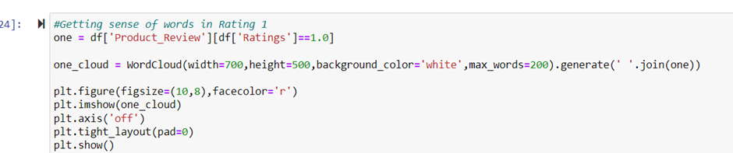
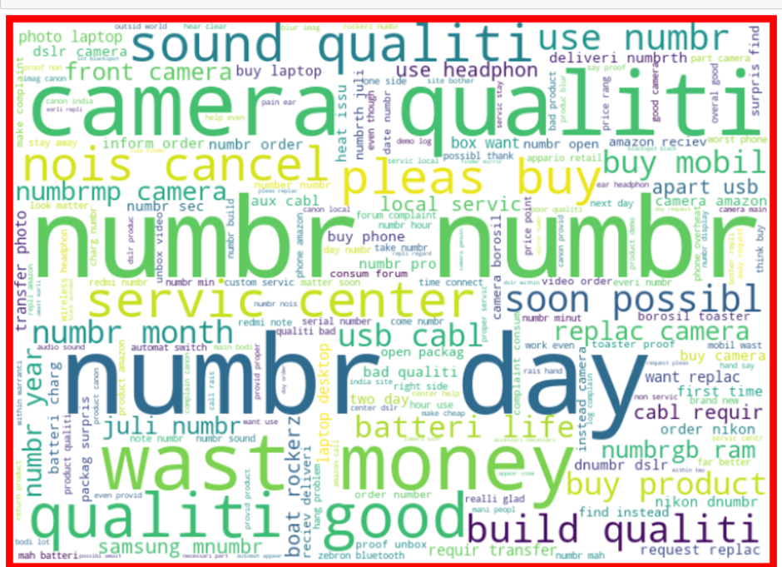
Getting sense of words for all ratings using WordCloud
Word Cloud is a data visualization technique used for representing text data in which the size of each word indicates its frequency or importance.
Similarly, we found the sense of words for ratings 2.0-5.0 and the output wil be as follows:
For rating 2.0

Slide 15
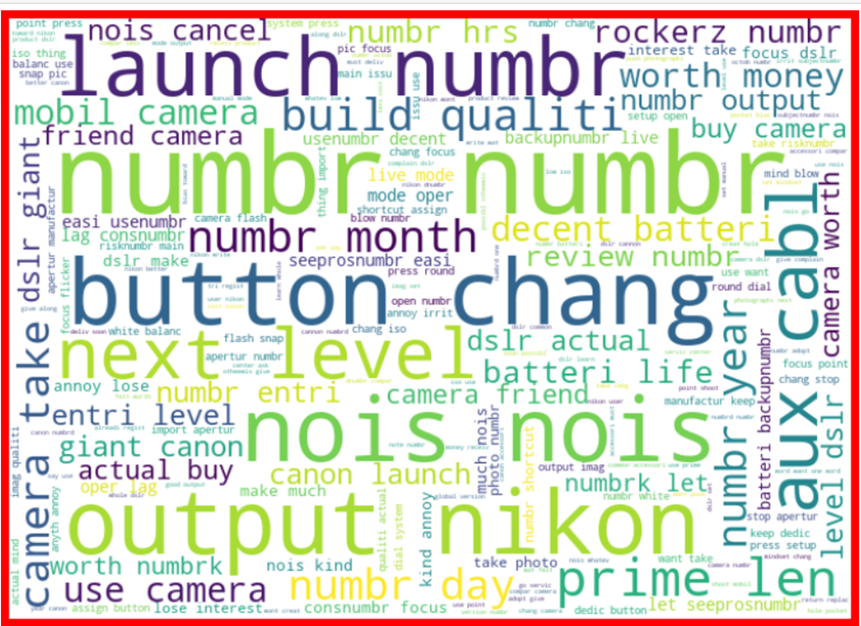
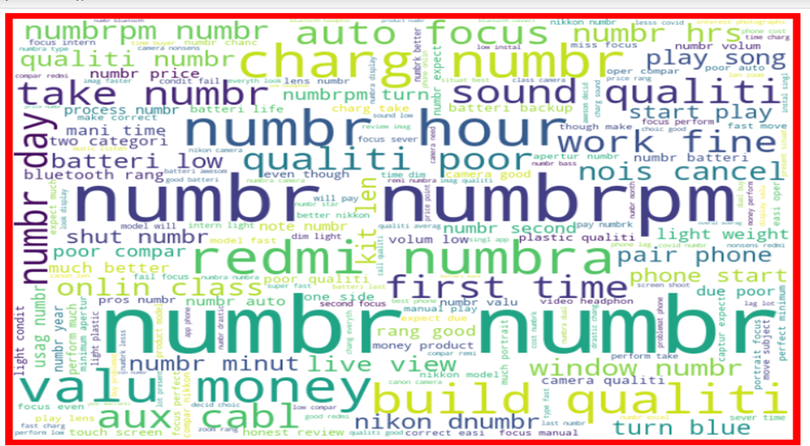
For rating 2.0
For rating 3.0

Slide 16
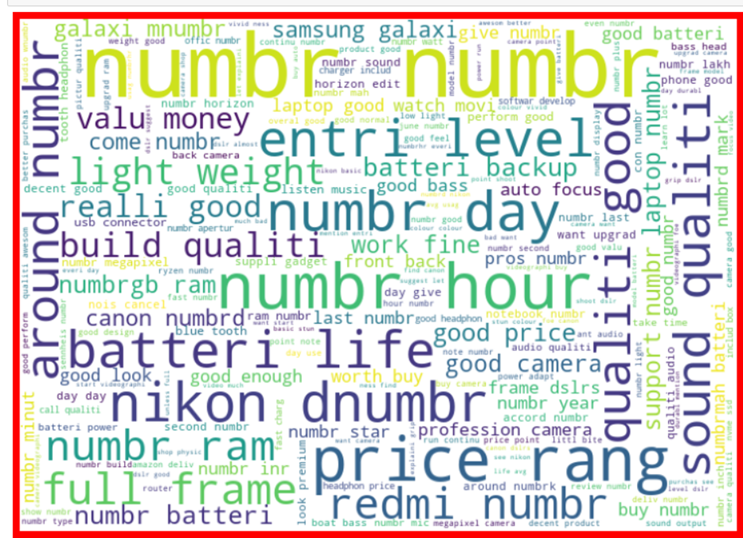
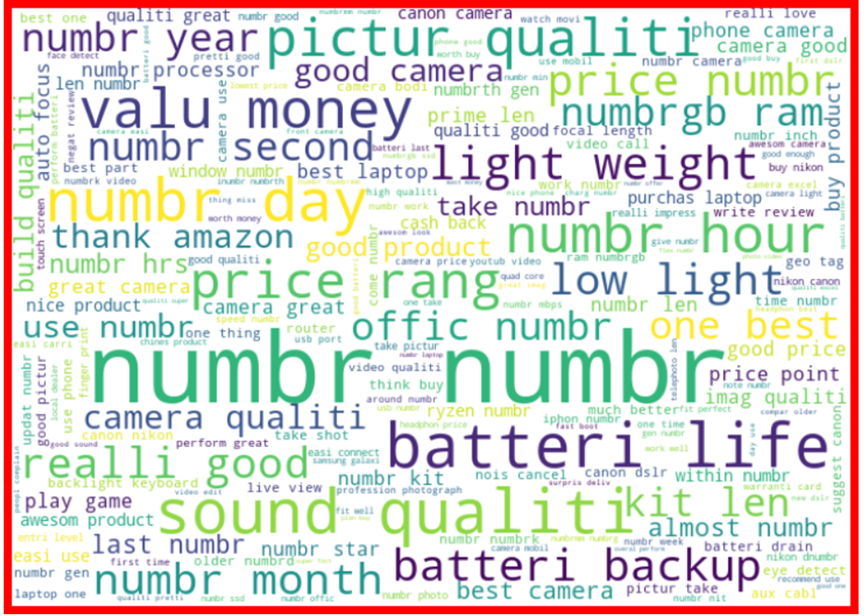
For rating 5.0
For rating 4.0

Slide 17
Observations:
-> The enlarged texts are the most number of words used there and small texts are the less number of words used.
-> It varies according to the ratings.
Feature Extraction:
Here we can finally convert our text to numeric using Tf-idf Vectorizer.
Term Frequency Inverse Document Frequency 9TF-IDF):
This is very common algorithm to transform text into a meaningful representation of numbers which is used to fit matching algorithm for prediction.

Slide 18
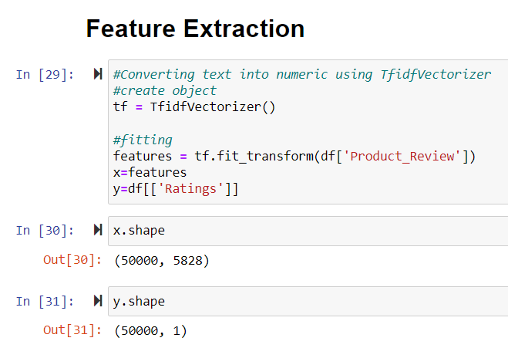
Feature extraction

Slide 19
• Hardware and Software Requirements and Tools Used
For doing this project, the hardware used is a laptop with high end specification and a stable internet connection.
While coming to software part, I had used anaconda navigator and in that I have used Jupyter notebook to do my python programming and analysis.
For using an CSV file, Microsoft excel is needed. In Jupyter notebook, I had used lots of python libraries to carry out this project and I have mentioned below with proper justification.

Slide 20
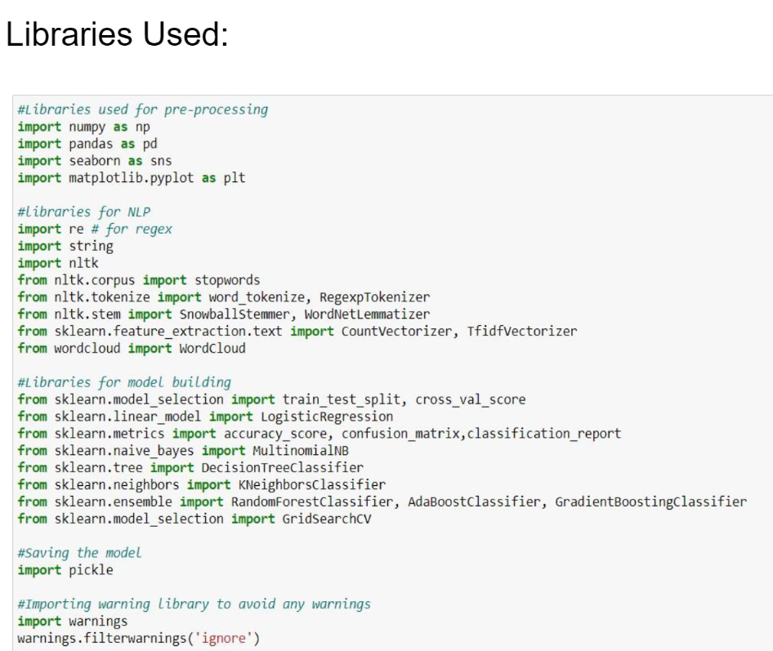
LIBRARIES USED

Slide 21
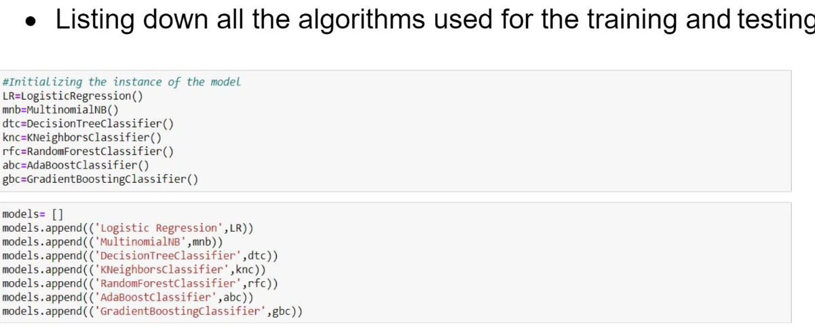
Model/s Development and Evaluation

Slide 22
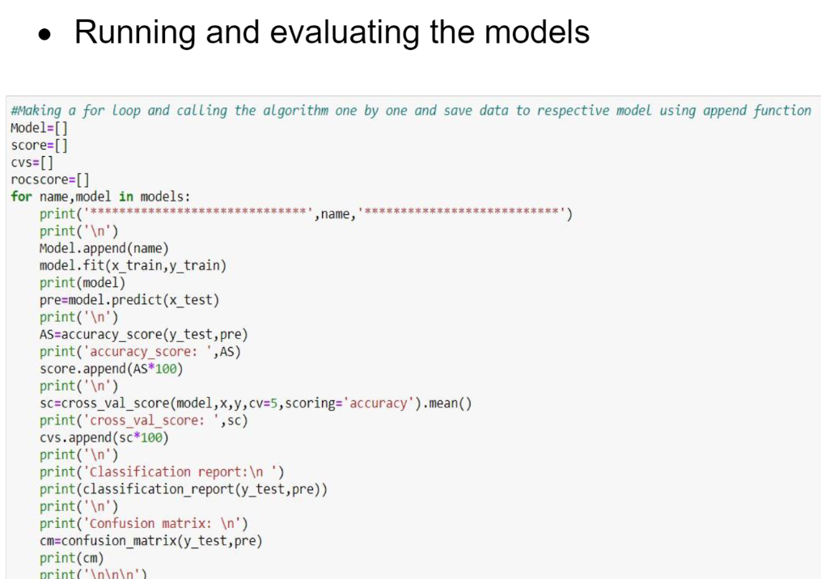

Slide 23
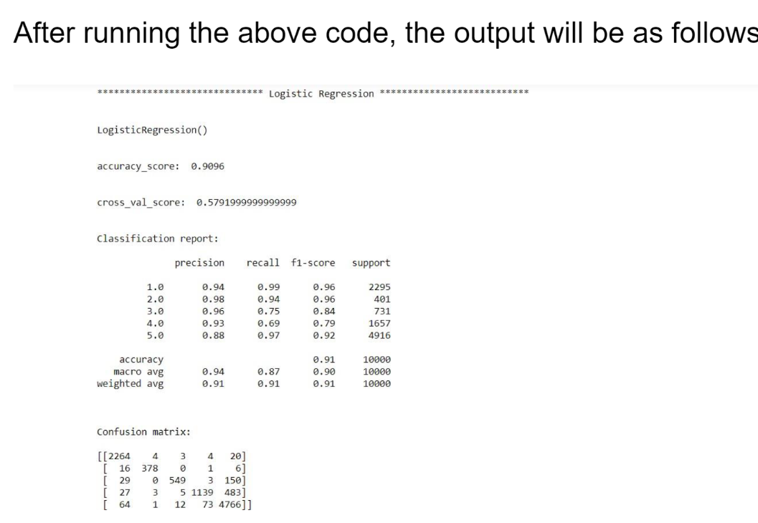

Slide 24
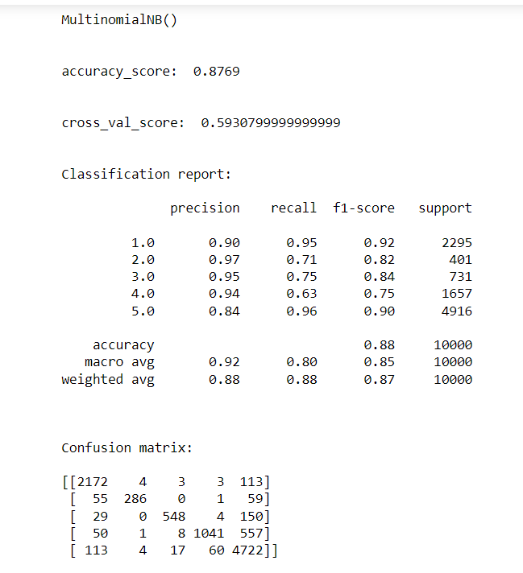
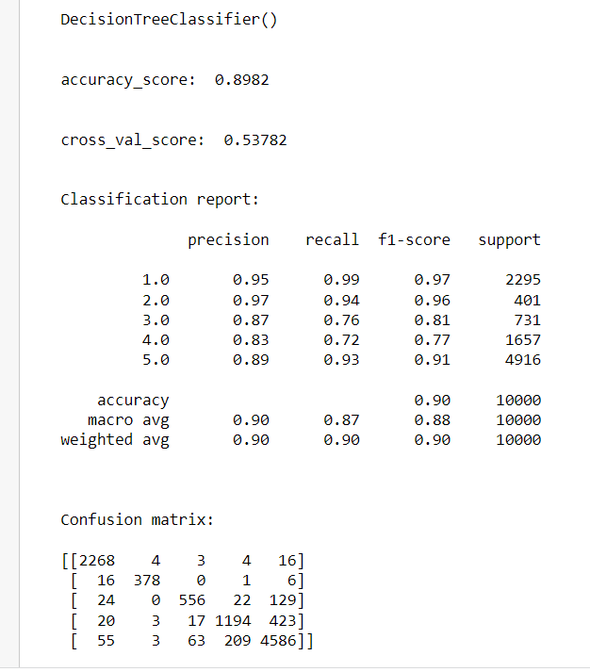

Slide 25
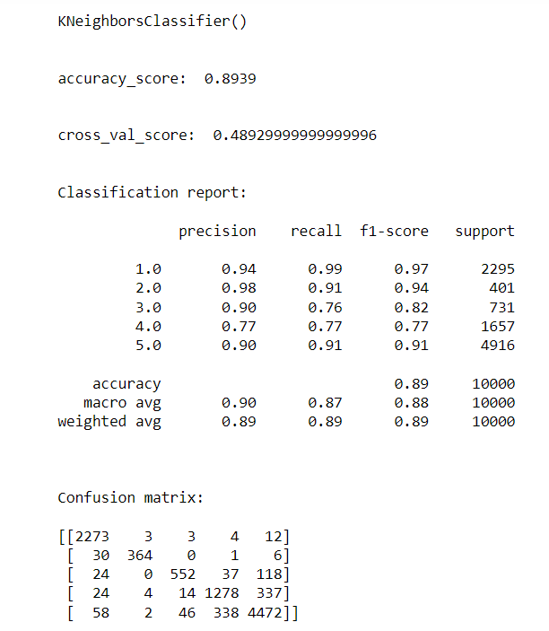
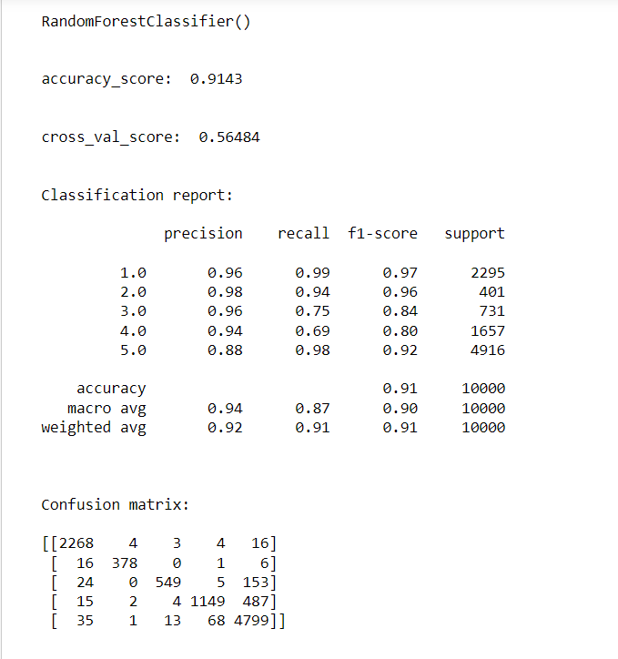

Slide 26
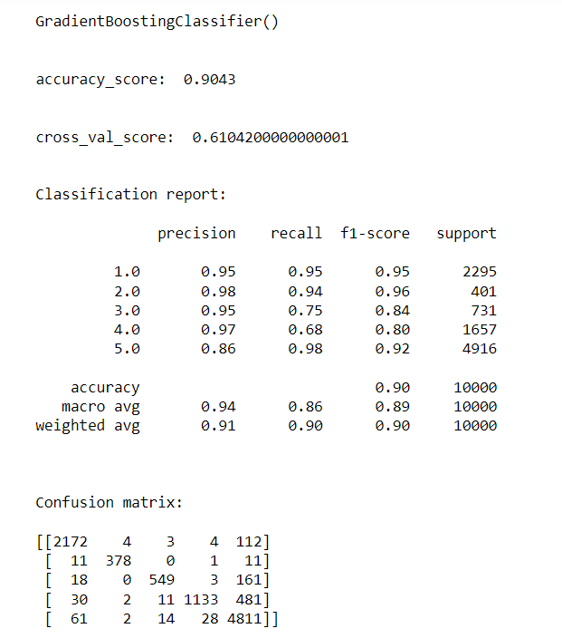
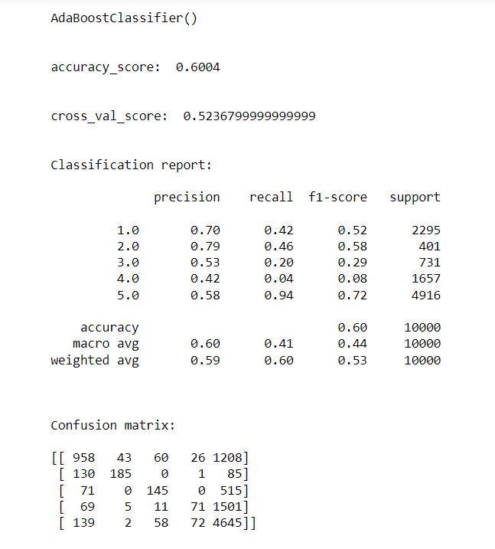

Slide 27
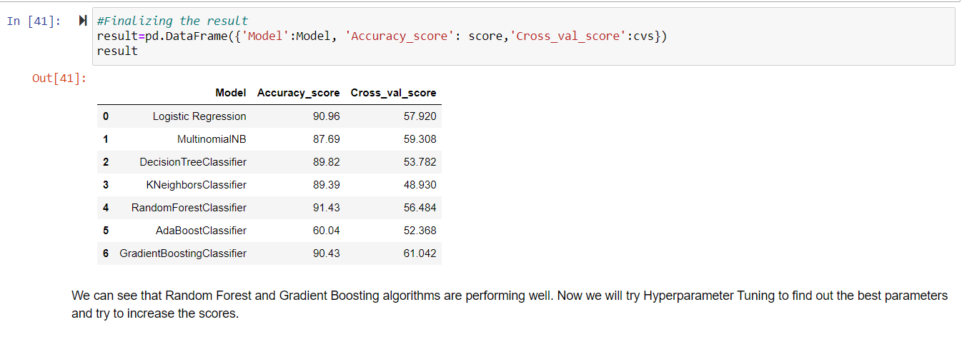
FINALIZING THE RESULT

Slide 28
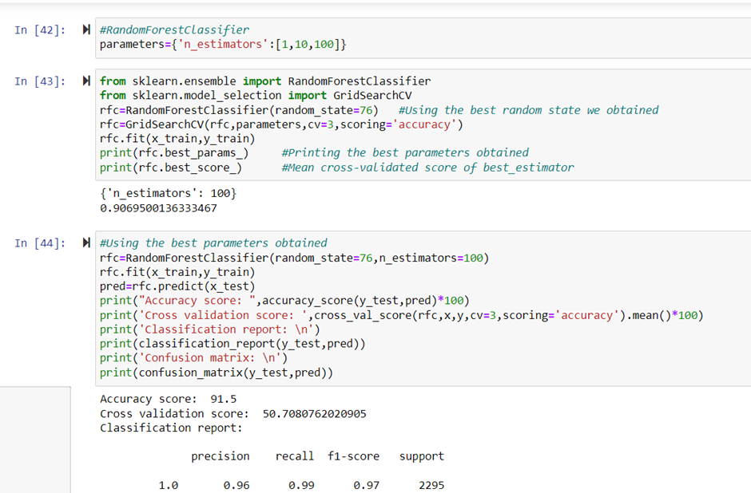
• Key Metrics for success in solving problem under consideration
Cross Validation
Confusion Matrix
Classification Report
Hyperparameter Tuning

Slide 29
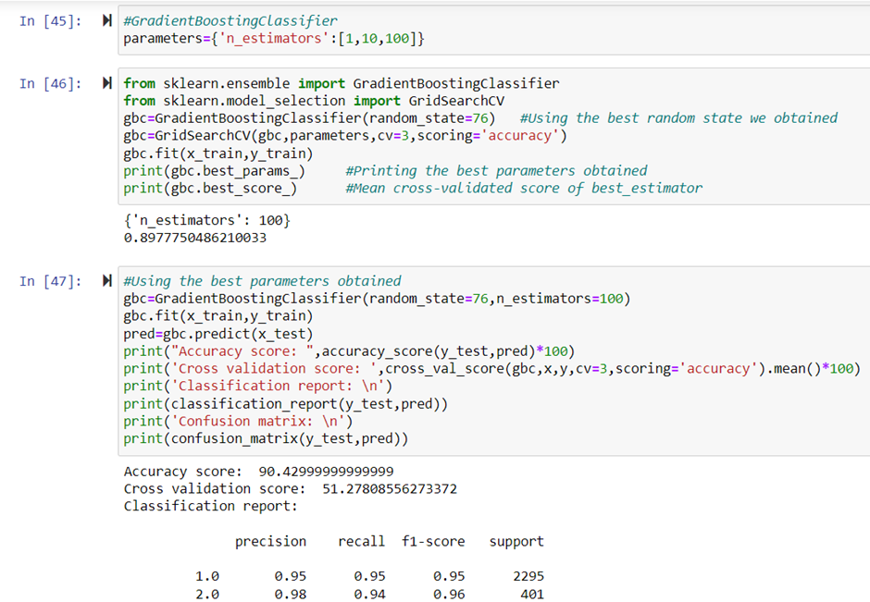
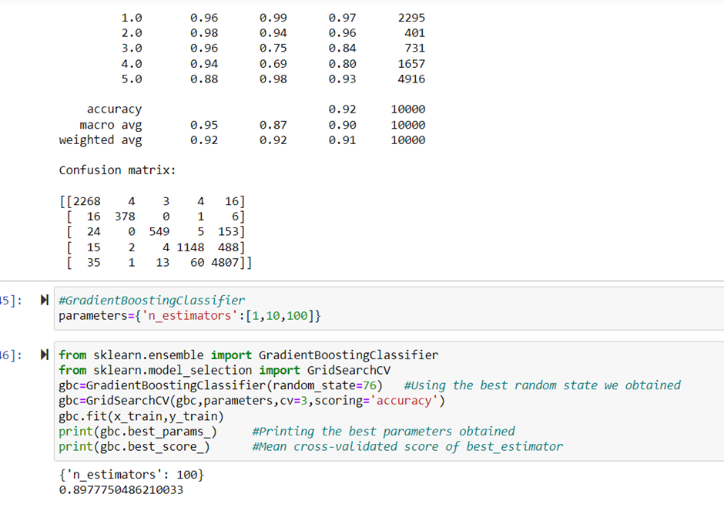

Slide 30
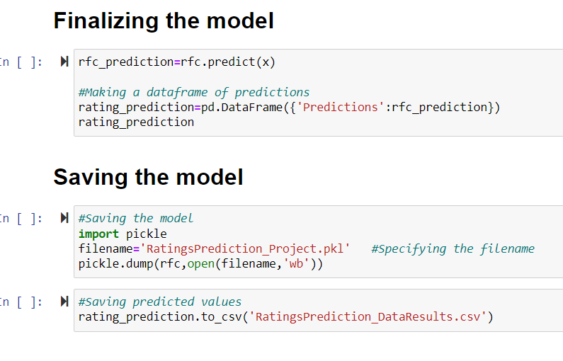
Finalizing and saving the model

Slide 31
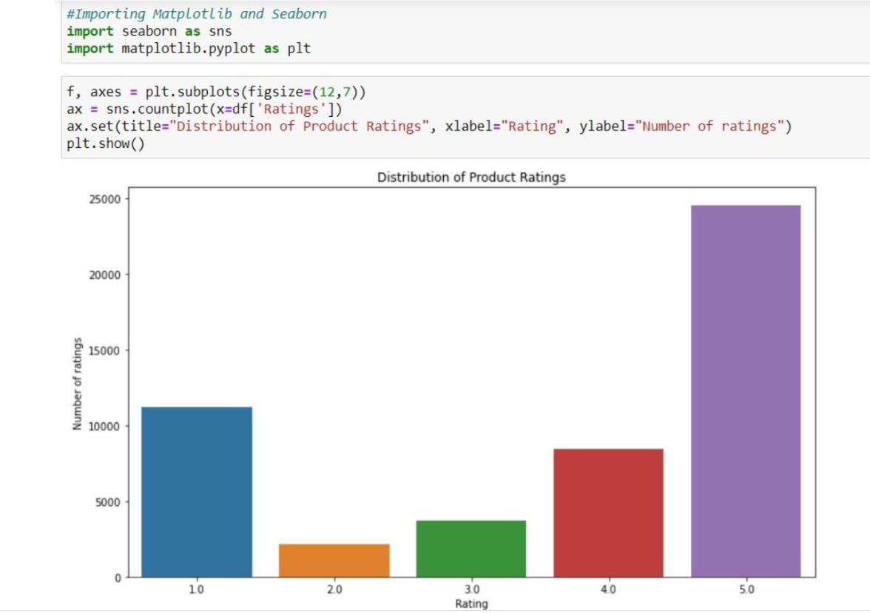
DATA VISUALIZATION

Slide 32
Conclusion
Key findings of the study
After the completion of this project, we got an insight of how to collect data, preprocessing the data, analyzing the data and building a model.
First, we collected the reviews and ratings data from different e-commerce websites like Amazon and Flipkart and it was done by using Webscraping. The framework used for webscraping was Selenium, which has an advantage of automating our process of collecting data.
We collected almost 50000 of data which contained the ratings from 1.0 to 5.0 and their reviews.
Then, the scrapped data was combined in a single dataframe and saved in a csv file so that we can open it and analyze the data.

